Slide 1

Clients’ churn prediction
Valentyn Burenkov

Slide 2

Aim of the model
Business goal
To retain clients before 2 months of their actual churn (no incoming events, no outgoing events, no paid events)
Task
To detect clients that will churn in 2 month
Task type
Binary classification

Slide 3
Business understanding
1) Enhanced understanding of the client’s future behavior
2) Marketing companies, intended to retain the client
3) Income prediction

Slide 4
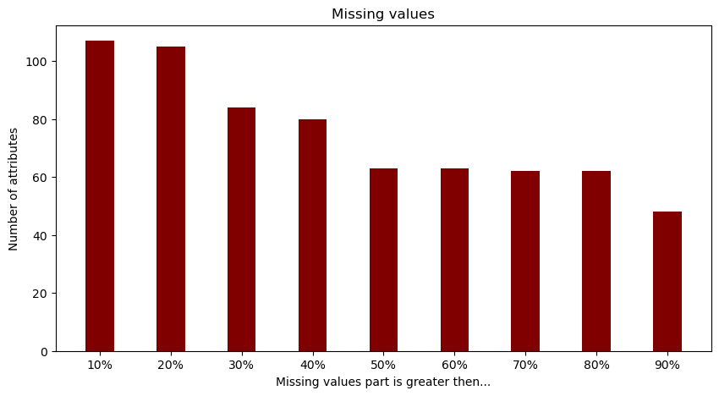
Input data understanding
Input data description
General information about clients (300_000 rows, 816 characteristics)

Slide 5
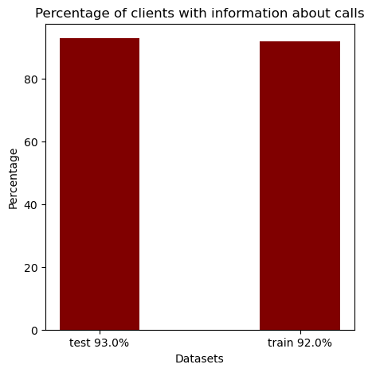
Input data understanding
Input data description
Information about clients calls (1_340_788 rows, 8 characteristics, average number of calls per number 4.83)

Slide 6
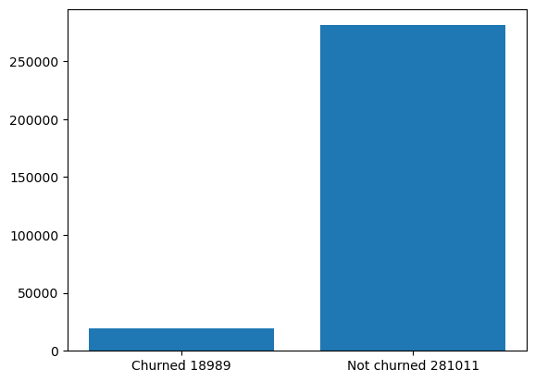
Is dataset balanced
6%
94%

Slide 7
Algorithm selection
LightGBM
Gives best AUC by default (add comparison between models)
Faster training speed and higher efficiency.
Lower memory usage . (change for non-technical)
Better accuracy. . (change for non-technical)
Support of parallel, distributed, and GPU learning. (change for non-technical)
Capable of handling large-scale data.

Slide 8
Iterative feature selection flow chart

Slide 9
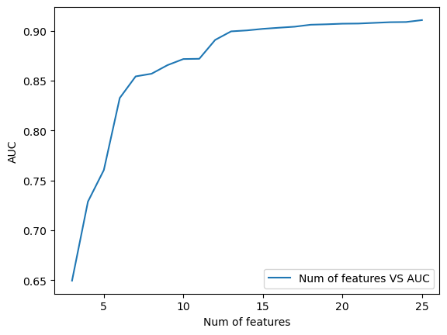
Number of features vs AUC

Slide 10
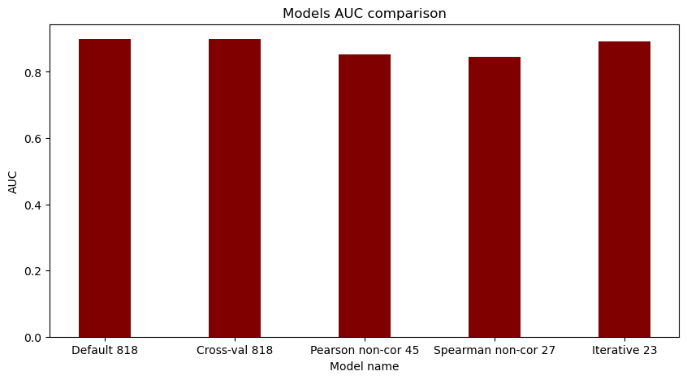
Feature selection techniques comparison
Explain

Slide 11
Telephone feature engineering
Check inbound calls from non-vodafone number in minutes
Check outbound calls to non-vodafone number in minutes
SMS from non-vodafone number count
SMS to non-vodafone number count
SMS to pawnshops, micro credit organizations
SMS from pawnshops, micro credit organizations
Total features taken to final mode: 0

Slide 12
Application feature engineering
Add the following information for every user for every application he is using.
Explain
Total applications: 776
Total features taken to final mode: 9

Slide 13
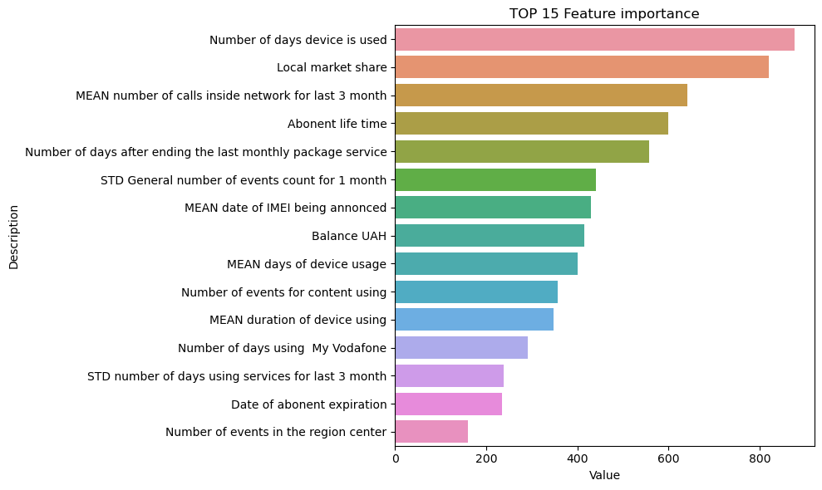
Final feature set has 32 features Top 15

Slide 14
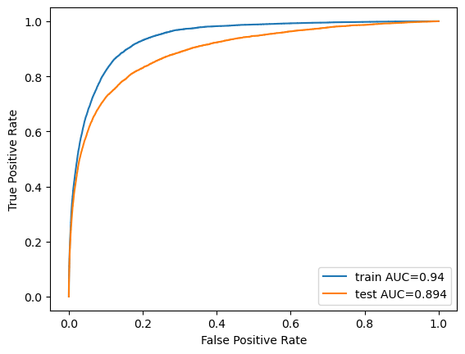
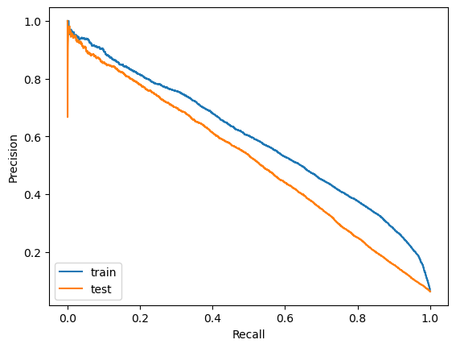
Metrics Train AUC = 0.94 Test AUC = 0.894 simplify
ROC curve answers the question of how well the model performs with no knowledge of the class imbalance, whilst the PR curve uses our estimated class imbalance baseline to inform us of how well our model performs, given the specific imbalance we provided it.
Precision-Recall (PR) curve is specifically tailored for the detection of rare events and is the metric that should be used when the positive class is of more interest than the negative one

Slide 15
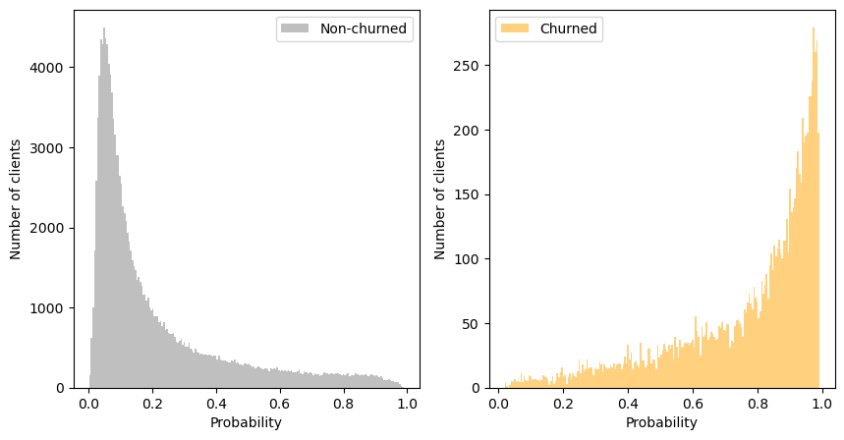
Probability distribution

Slide 16
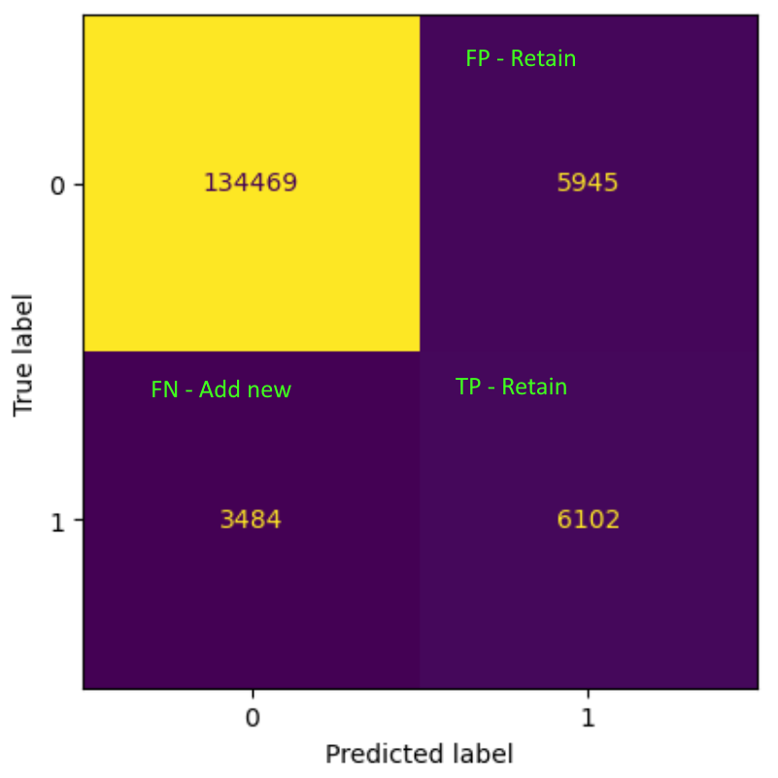
F1 based threshold selection 0.23

Slide 17
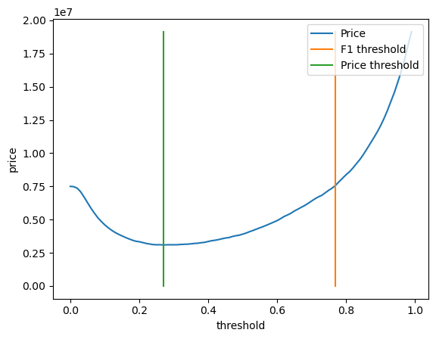
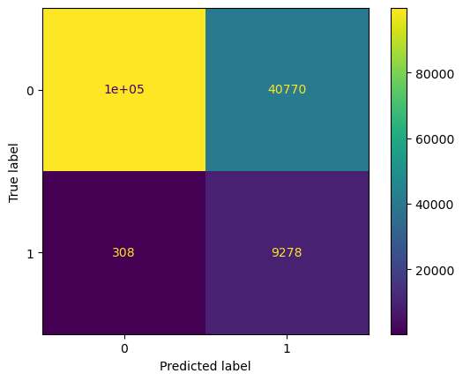
Expenses based threshold 0.78
Expenses = TP* RETAIN + FP*RETAIN + FN*ADD_NEW
Let’s assume that retain price is 50 UAH, add new client price (including missed income) is 4000 UAH.
F1 price: 14_573_400 UAH
Price based: 3_734_400 UAH
Do nothing: 38_344_000 UAH

Slide 18
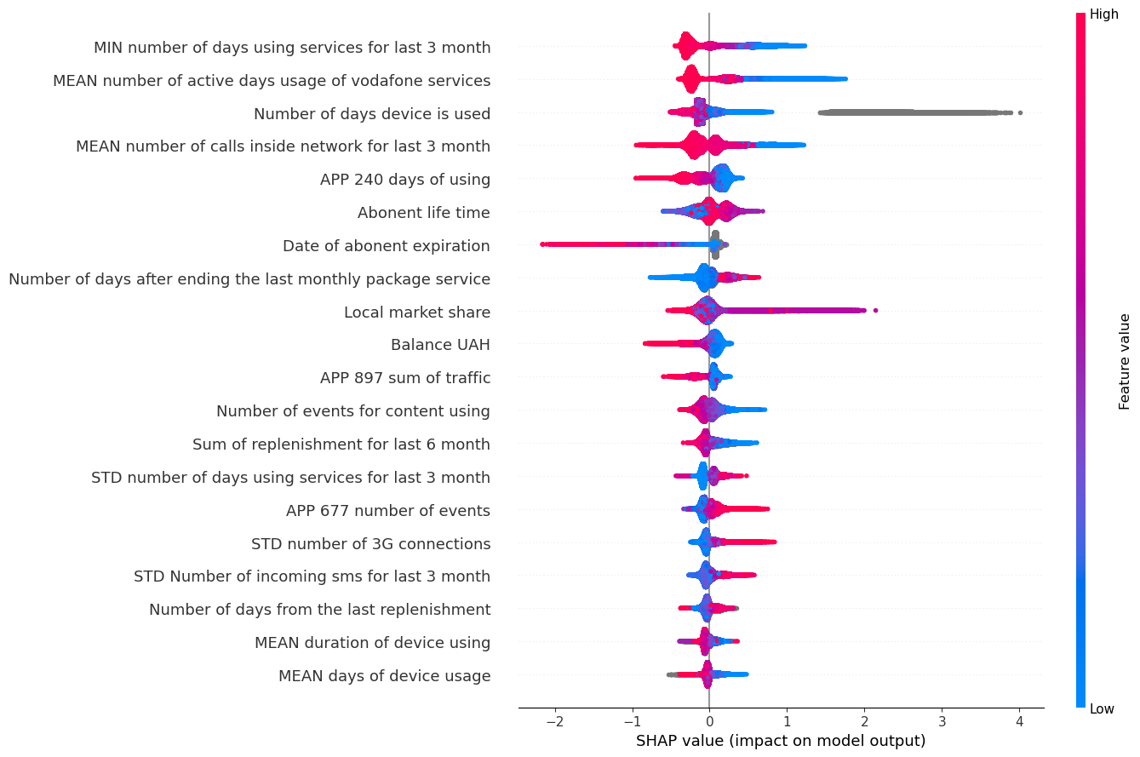
SHAP 1) App 240 less using – churn 2) App 897 less traffic – churn 3) App 677 more events – churn 4) More 3G – churn 5) Number of incoming sms increase – churn to another slide

Slide 19
Future enhancements non-technical
Use model ensembles
Use models of different types
Generate another features from telephones dataset
Analysis where model makes wrong predictions

